Slide 1
HR DaSHBOARD
Shiladitya Bhattacharjya

Slide 2
REPORT Overview
Attendance and performance seem to be relatively stable across these departments, with HR having slightly lower performance compared to Sales and R&D.
Training Hours vs. Monthly Performance: There seems to be a negative correlation between training hours and monthly performance, as shown by the scatter plot. This suggests that more training hours may not necessarily lead to better performance in this case.
Age Group-wise Average Performance: The average monthly performance is slightly better for older age groups: A.20-30: 2.95 B.30-40: 2.95 C.40-50: 3.14 D.50-60: 3.03 This shows that performance does not significantly vary with age but the group C.40-50 has the highest average performance.
Age Group Count by Gender: The gender-wise performance category distribution for age groups shows that the A.20-30 and C.40-50 age groups have a larger number of poor performance ratings.
There are 109 employees in the A.20-30 group, with a majority (48) in the Poor category. The C.40-50 group also has a higher number in the Poor category (24), though it is a smaller group overall (53 employees).
Training Insights: While training ahours may not be correlated with performance improvement, the Age Group-wise Performance comparison could indicate that more experienced employees (older age groups) may require different kinds of development programs, possibly leadership or advanced skills training.
In summary, the data suggests that: A significant portion of the workforce is underperforming. There could be a mismatch between training hours and performance outcomes. Employee performance seems to have some variation by age group, but training might need to be more targeted for different groups.
Performance Ratings: The Monthly Performance Rating distribution shows that most employees are rated as D.Poor (155 employees), followed by A.Best (63 employees), C.Average (62 employees), and a small number being rated as B.Good (31 employees).
This suggests that the overall performance level of the workforce could be lower, with a significant number of employees falling into the poor performance category.
Department-wise Attendance Heatmap: The departments listed are Sales, Research & Development, and Human Resources, with performance scores of 86.30, 86.23, and 80.91 respectively.
Workforce Demographics:
Total workforce: 311 employees
Gender split: Male majority at 56.59% (176 employees) vs Female at 43.41% (135 employees)
Average age is 40 years
Largest age groups are 30-40 and 40-50, with 109 employees each (35% each of total workforce)
Departmental Structure:
Research & Development is the largest department (207 employees)
Sales has 93 employees
Human Resources is the smallest with only 18 employees
R&D shows a mature workforce profile with a high concentration in the 30-50 age range
Critical Hiring/Attrition Patterns:
Significant attrition spike in March (32 departures)
Notable hiring activity in January (30 joins) and August (30 joins)
December shows a concerning trend with low hiring (5) vs higher attrition (21)
Overall attrition pattern appears cyclical with peaks every 4-5 months
Geographical Distribution:
Operations concentrated in India with multiple locations
Major clusters visible around New Delhi and southern regions
Widespread presence across different regions indicates a decentralized workforce structure
Address gender balance, especially in senior roles (considering age-gender distribution)
Develop retention strategies to reduce the high attrition in the March-April period
Review December hiring practices as they show consistently lower numbers
Consider strengthening HR team size relative to the total workforce for better employee support
Implement targeted retention programs for the 30-50 age group as they form the core workforce
Performance Score: The average performance score across the data is 3.05, which could indicate moderate engagement across the workforce.

Slide 3
REPORT Overview
The average salary across all departments is $79.41K
Three main departments: Research & Development, Sales, and Human Resources
Department-wise Analysis:
R&D has the highest average salary ($79.47K) and total salary budget ($16,450.39K)
Sales follow closely with $79.35K average and $7,379.92K total
HR has slightly lower averages at $78.77K and $866.47K total
Bonus Trends:
Data shows bonus distributions for 2021 and 2022
The highest bonus peaks occur in March and July (3.7K)
Notable fluctuations throughout the year
Generally, bonuses range between 0.5K to 3.7K monthly
Performance Correlation:
The scatter plot shows salary vs monthly performance ratings (1-5 scale)
Performance ratings appear fairly distributed
No clear direct correlation between performance ratings and salary
All three departments show mixed performance ratings
Declining Attrition Rate: The overall attrition rate is decreasing, which is a positive sign, especially with the significant dip in March 2022.
Experience and Retention: Given that the average experience is low, it may be worth investigating if this attrition is mostly from newer employees who are either not staying long enough to develop their careers or are seeking better opportunities.
Conclusion: The dashboard highlights a workforce experiencing relatively high attrition, particularly in R&D and Sales, with a notable decrease in attrition rates into 2022. The main drivers seem to be retirement and resignation, and understanding voluntary attrition in more detail can help address retention strategies.
Average Experience: The average experience of the employees shown is 1.97 years, which suggests a relatively young workforce with less than 2 years of experience on average.
Department-wise Attrition: Research & Development has the highest attrition count with 113 employees, followed by Sales with 41 employees, and Human Resources with 4 employees. Among these, R&D and Sales are the most affected departments in terms of attrition, with R&D having a significant lead.
Reason for Attrition: The main reasons for employee attrition are Retirement (45 employees) and Resignation (40 employees), indicating that employees leaving voluntarily due to retirement and resignation are the primary factors.
There are also employees leaving due to Involuntary reasons (39 employees) and Voluntary reasons (34 employees), though these are relatively fewer in number.
Monthly Attrition Rate Comparison: Attrition rates in 2021 began at 12.9% in January and saw a significant decline, dropping to as low as 5.5% by March 2022. The 2022 attrition rate shows a decrease across most months, with March 2022 seeing the lowest rate at 5.5%, suggesting a significant reduction in overall attrition after the first quarter of 2022.
The 2021 attrition rate remained relatively stable until it declined sharply in October and continued to show a downward trend into 2022.
Key Insights: High Attrition in R&D: The R&D department has the highest number of exits, and attention may be needed to understand if specific factors like job satisfaction, workload, or compensation are contributing to this trend.
Voluntary Attrition: Retirement and resignation are the main reasons for attrition, especially voluntary resignation, which could be a sign of employee dissatisfaction or better opportunities elsewhere.

Slide 4
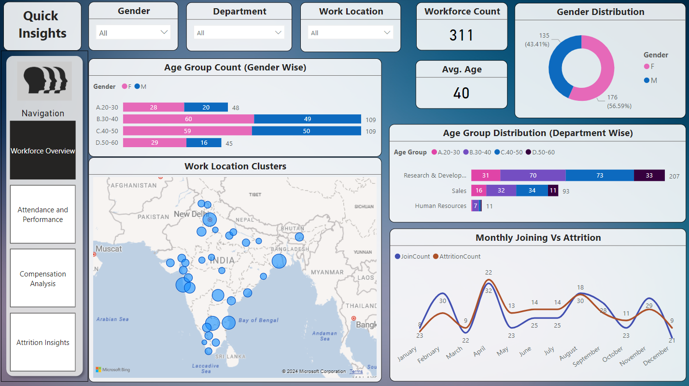
Departmental Structure:
Research & Development is the largest department (207 employees)
Sales has 93 employees
Human Resources is the smallest with only 18 employees
R&D shows a mature workforce profile with a high concentration in the 30-50 age range

Slide 5
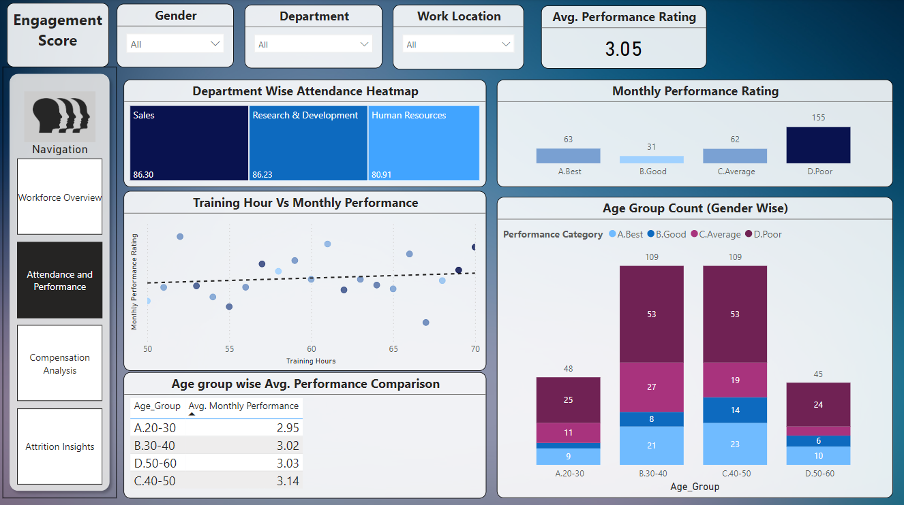
Performance Score: The average performance score across the data is 3.05, which could indicate moderate engagement across the workforce.
Performance Ratings: The Monthly Performance Rating distribution shows that most employees are rated as D.Poor (155 employees), followed by A.Best (63 employees), C.Average (62 employees), and a small number being rated as B.Good (31 employees).
Age Group-wise Average Performance: The average monthly performance is slightly better for older age groups: A.20-30: 2.95 B.30-40: 2.95 C.40-50: 3.14 D.50-60: 3.03 This shows that performance does not significantly vary with age but the group C.40-50 has the highest average performance.
Department-wise Attendance Heatmap: The departments listed are Sales, Research & Development, and Human Resources, with performance scores of 86.30, 86.23, and 80.91 respectively.
Attendance and performance seem to be relatively stable across these departments, with HR having slightly lower performance compared to Sales and R&D.
Training Hours vs. Monthly Performance: There seems to be a negative correlation between training hours and monthly performance, as shown by the scatter plot. This suggests that more training hours may not necessarily lead to better performance in this case.

Slide 6
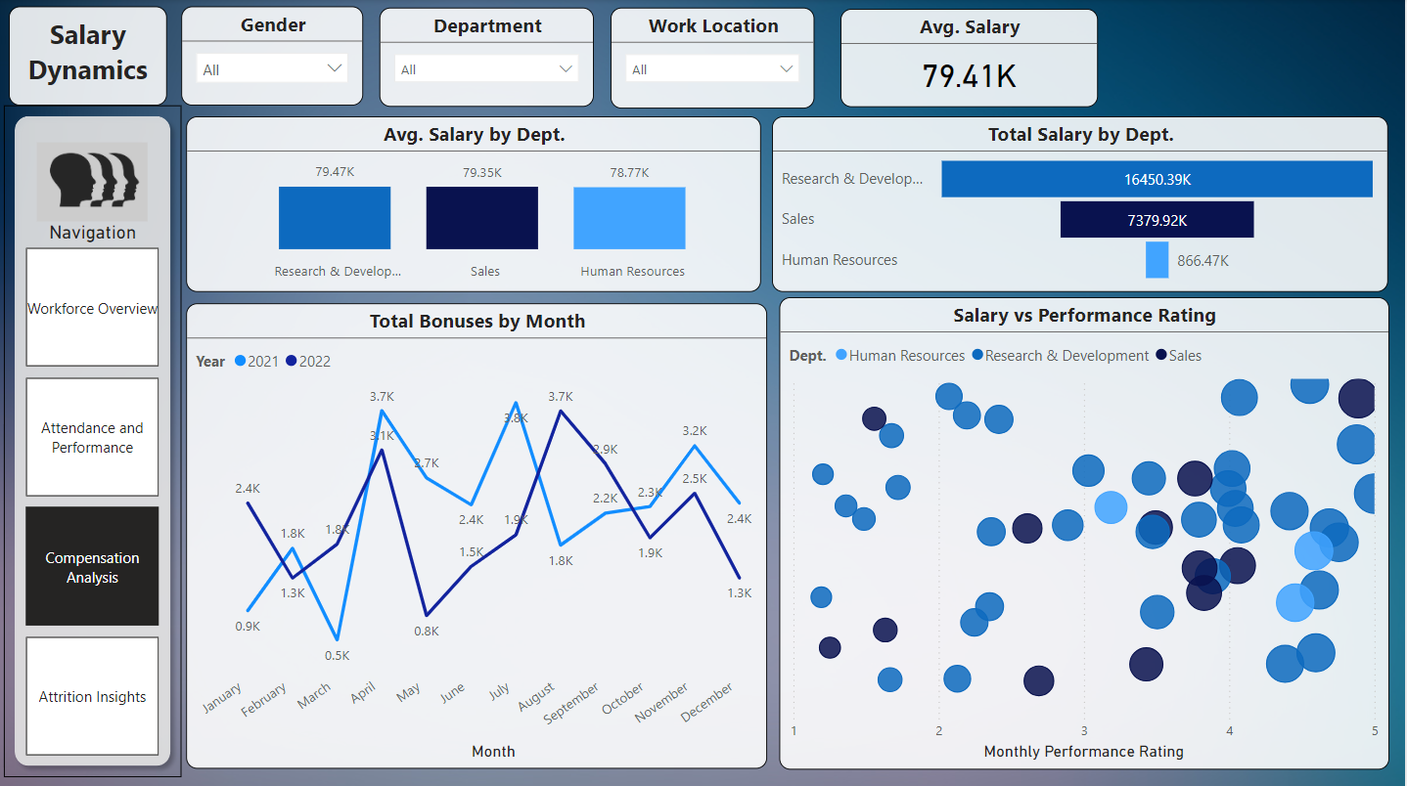
Bonus Trends:
Data shows bonus distributions for 2021 and 2022
The highest bonus peaks occur in March and July (3.7K)
Notable fluctuations throughout the year
Generally, bonuses range between 0.5K to 3.7K monthly
Performance Correlation:
The scatter plot shows salary vs monthly performance ratings (1-5 scale)
Performance ratings appear fairly distributed
No clear direct correlation between performance ratings and salary
All three departments show mixed performance ratings
Overall Picture:
The average salary across all departments is $79.41K
Three main departments: Research & Development, Sales, and Human Resources
Department-wise Analysis:
R&D has the highest average salary ($79.47K) and total salary budget ($16,450.39K)
Sales follow closely with $79.35K average and $7,379.92K total
HR has slightly lower averages at $78.77K and $866.47K total

Slide 7
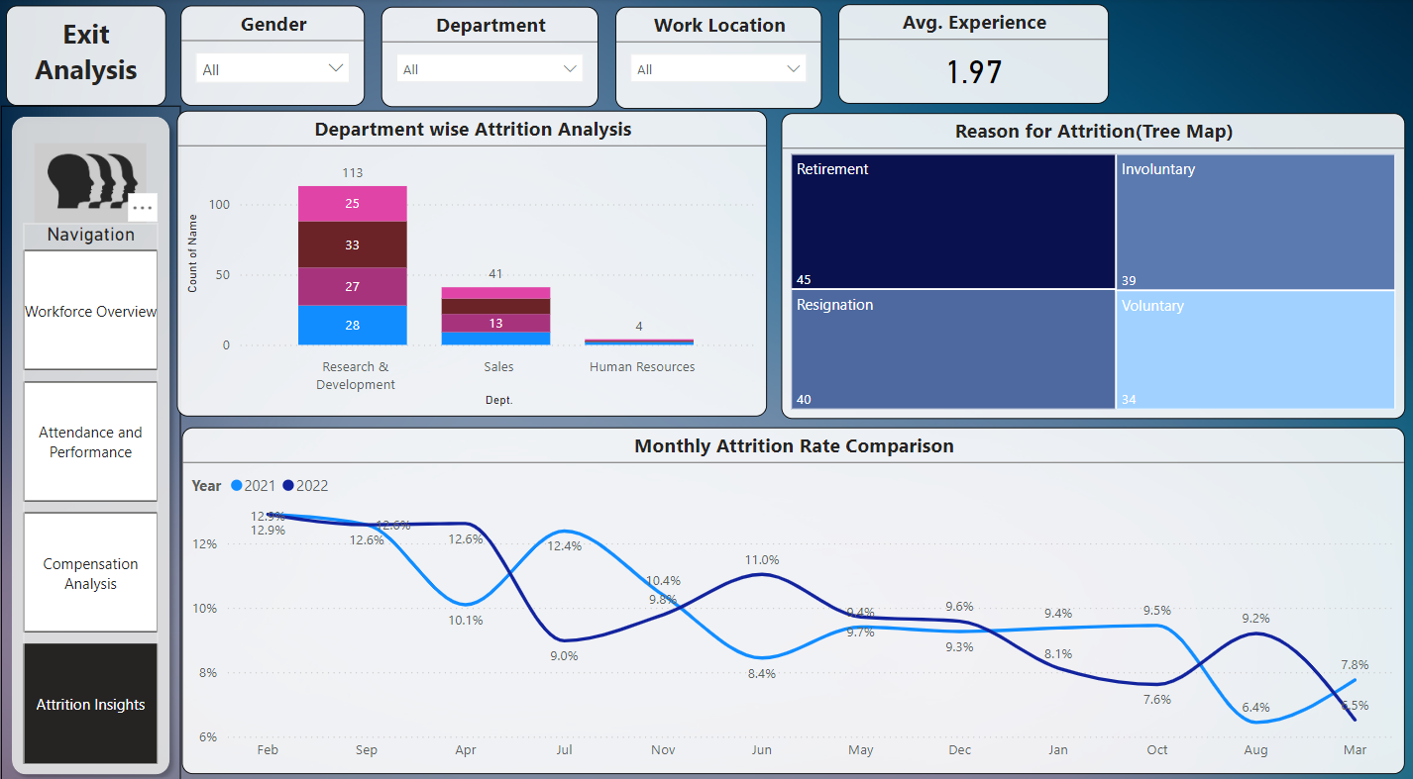
Average Experience: The average experience of the employees shown is 1.97 years, which suggests a relatively young workforce with less than 2 years of experience on average.
Department-wise Attrition: Research & Development has the highest attrition count with 113 employees, followed by Sales with 41 employees, and Human Resources with 4 employees. Among these, R&D and Sales are the most affected departments in terms of attrition, with R&D having a significant lead.
There are also employees leaving due to Involuntary reasons (39 employees) and Voluntary reasons (34 employees), though these are relatively fewer in number.
Monthly Attrition Rate Comparison: Attrition rates in 2021 began at 12.9% in January and saw a significant decline, dropping to as low as 5.5% by March 2022. The 2022 attrition rate shows a decrease across most months, with March 2022 seeing the lowest rate at 5.5%, suggesting a significant reduction in overall attrition after the first quarter of 2022.
The 2021 attrition rate remained relatively stable until it declined sharply in October and continued to show a downward trend into 2022.

Slide 8
Thank You

